Slide 1
Project – 4 : Feature Extraction and Price Prediction for Mobile Phones
Company Name:- NextHikes IT Solution
Ashish Pachauri

Slide 2
Project Overview
Objective: Predict mobile phone prices using extracted features.
The primary aim of this project is to develop a reliable and accurate pricing prediction mechanism for mobile phones. This involves leveraging machine learning (ML) techniques to predict phone prices based on specific attributes (features). By doing so, it empowers businesses and consumers to make better decisions about pricing strategies and purchasing options.
Building Machine Learning Models:
Feature Selection/Engineering:
Model Selection:
Evaluation Metrics:
Hyperparameter Tuning:

Slide 3
Project started by loading and exploring the dataset to understand its structure, data types, the range of values for each feature etc.
Import Important Liabraries
import pandas as pd
import numpy as np
from sklearn.model_selection import train_test_split
from sklearn.tree import DecisionTreeRegressor
from sklearn.svm import SVC
from sklearn.neighbors import KNeighborsClassifier
from sklearn.preprocessing import LabelEncoder
from sklearn.metrics import mean_squared_error, r2_score
from sklearn.compose import ColumnTransformer
from sklearn.ensemble import RandomForestRegressor

Slide 4
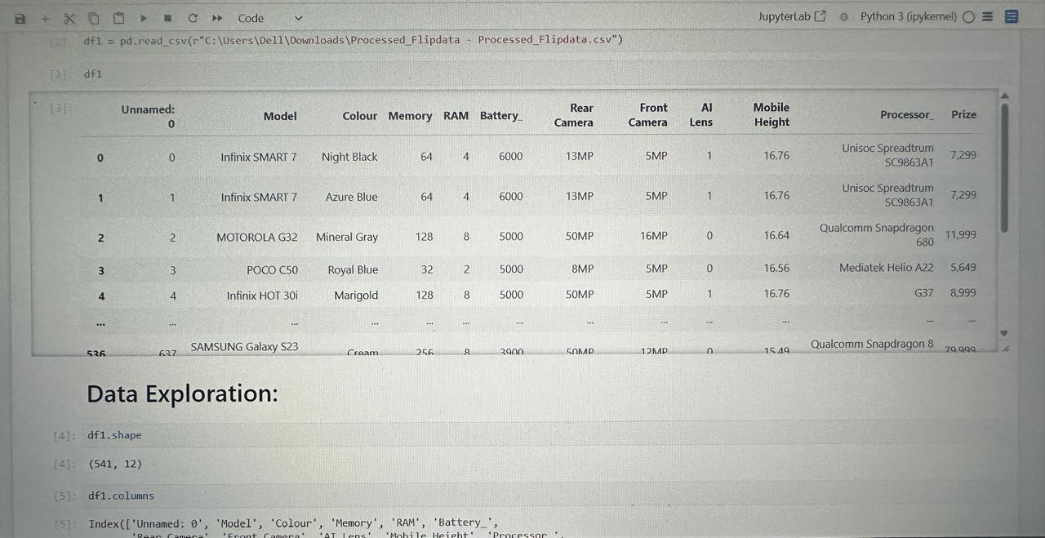
Project started by loading and exploring the dataset to understand its structure, data types, the range of values for each feature etc.

Slide 5
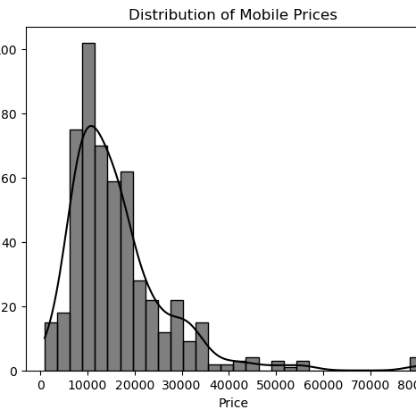
Price Prediction: The observed skewness and
concentration at lower price points highlight the
importance of feature selection and transformation
to handle this imbalance.
Market Segmentation: This visualization could be
a foundation for segmenting the market into budget, mid-range, and premium categories.
The rapid drop in frequency beyond 15,000 indicates that budget and mid-range devices are far more common than high-end models, potentially reflecting consumer demand for affordability and balanced features.

Slide 6
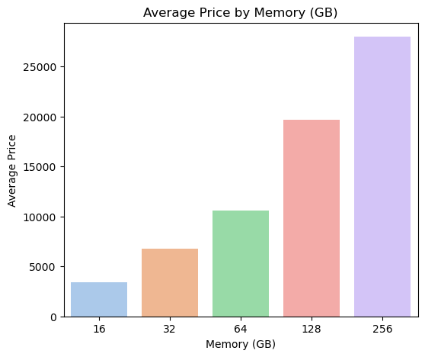
Price vs Memory
Strong Upward Trend: There’s a clear rise in average price with increasing memory capacity—from around 2,500 for 16 GB devices to about 25,000 for 224 GB devices. This suggests that manufacturers consistently position higher-memory models at a premium.
Devices with prices significantly higher than the general range in their memory category, particularly for models with 32 GB or 64 GB memory, could indicate premium branding, advanced features (like high-resolution cameras or processors), or limited-edition products.
If there are devices with unusually low prices in higher memory categories (like 128 GB or 224 GB), they might be budget models or from lesser-known brands offering aggressive pricing to capture the market.

Slide 7
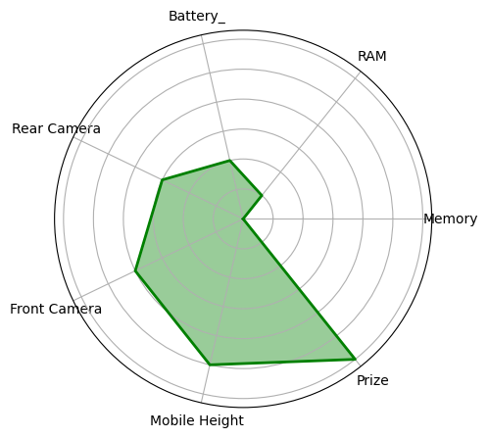
Radar Chart
The plot is called a Radar Chart, also known as a Spider Chart. It is particularly useful for visualizing multivariate data,
Balanced Attributes: The chart demonstrates a relatively even distribution across categories like Memory, Battery, and Mobile Height. This indicates the device is well-rounded in these aspects.
Memory (Storage) is also strong, making it suitable for users who store significant amounts of data, such as photos, videos, or apps.
Pricing Alignment: Based on the shape of the chart, the Prize appears proportional to the overall specifications. This suggests that the device's price is justified by its features.
Mobile Height: The Mobile Height aligns with current trends for standard-sized smartphones, neither bulky nor ultra-compact. This fits well into the mainstream market.

Slide 8
Model Building & Selection
Model: LinearRegression
Model: RandomForestRegressor
Model: Decision Tree
Evaluation Metrics: Mean Absolute Error, Mean Squared Error, R-squared Score.
Linear Regression is ideal for simple, linear data with minimal complexity.
Random Forest Regressor is powerful for complex datasets with multiple interacting features.
Decision Tree provides intuitive insights into decision-making processes but may require pruning or ensemble methods to improve stability.

Slide 9
Linear Regression
Overview: Linear regression is a simple and interpretable model that predicts a target value by fitting a straight line (or hyperplane) to the input data.
Use Case: It's often used for predicting continuous variables, like mobile phone prices, based on a set of numerical features such as RAM, storage, and camera specifications.
Advantages:
Easy to implement and computationally efficient.
Works well when the relationship between features and the target is linear.
Disadvantages:
Struggles with non-linear relationships.
Sensitive to outliers, which can skew the predictions.
2. Random Forest Regressor
Overview: A Random Forest is an ensemble model that combines multiple decision trees to improve prediction accuracy and reduce overfitting.
Use Case: Effective for capturing complex relationships in datasets with multiple features, such as predicting mobile prices by accounting for interactions between RAM, battery, and camera.
Advantages:
Handles non-linear relationships effectively.
Reduces the risk of overfitting by averaging predictions from multiple trees.
Works well even with missing or noisy data.
Disadvantages:
Requires more computational resources compared to simpler models.
Can be less interpretable than individual decision trees.

Slide 10
Decision Tree
Overview: A Decision Tree is a model that splits the dataset into subsets based on feature values, creating a tree-like structure for predictions.
Use Case: Useful for explaining and visualizing how specific features influence the target variable, such as determining price ranges based on RAM or camera specifications.
Advantages:
Easy to interpret and visualize.
Handles categorical and numerical data well.
Captures non-linear relationships.
Disadvantages:
Prone to overfitting if not pruned or regularized.
Less stable than ensemble methods like Random Forest.

Slide 11
Evaluation Metrics:
Mean Absolute Error (MAE):
Measures the average magnitude of errors in predictions, making it easy to interpret.
It doesn't highlight large errors since all errors are treated equally.
Mean Squared Error (MSE):
Penalizes larger errors more than MAE because errors are squared.
Useful for assessing models where large deviations are critical to minimize.
R-squared (R²) Score:
Indicates the proportion of variance in the target variable explained by the model.
A higher R² suggests a better fit to the data, with 1 being a perfect score.
By using a combination of these models, you can compare performance across different approaches and select the one that best fits the data's nature and complexity. Evaluation metrics provide a comprehensive way to assess accuracy (MAE/MSE) and the model's explanatory power (R²). For interpretable and simple data, Linear Regression or Decision Tree might suffice. For complex, non-linear data, Random Forest or SVR is likely more suitable. KNeighbors is ideal for exploring local patterns but might require careful tuning of the number of neighbors.

Slide 12
Conclusion
From the above table we can say that RandomForest Regressor is the best model.
Based on the scores provided for various algorithms, here are the conclusions:
Best Performing Algorithm:
RandomForestRegressor achieves the highest score of 97.91, indicating it is the most effective model for your data among the options evaluated. This suggests Random Forest captures the underlying patterns in the dataset better than the others.
Second Best Option:
DecisionTreeRegressor with a score of 99.98 also performs well but trails behind Random Forest. Decision Trees are often simpler but lack the robustness of ensemble methods like Random Forest.
Overall Recommendation:
Given the results, RandomForestRegressor is the optimal choice. It likely balances complexity and accuracy by leveraging an ensemble of Decision Trees to handle non-linear relationships effectively. DecisionTreeRegressor could be a good alternative if you require a simpler, more interpretable model but are willing to sacrifice some accuracy.

Slide 13
Thank you

